Slide 1

The writing process

Slide 2

Problems Faced by Writers
1- Writer’s block
(Plan well, apply planning techniques)
2-Lack of information
(Develop the habit of reading)

Slide 3
Steps in writing an essay
Pre-Writing
Understand the topic, purpose & Audience
Generate or search for ideas
While-Writing
Make an outline
Post-Writing
Proofread, revise, refine
Write the first draft
Edit and write final draft

Slide 4
The Process of Academic Writing
Pre-writing
Purpose & Audience
Brainstorming/Forms
While Writing
Organization/Voice
Word Choice/Sentence Fluency
Post Writing
Finalizing draft/publishing
First draft
Evaluation/revising
Proofreading/ Editing

Slide 5
Scheduling the Writing Process
Writing—25 percent
[organizing and composing]
Prewriting—25 percent
[
Revising—50 percent
[45 percent revising and 5 percent proofreading]

Slide 6
Pre writing: Assess the Writing Situation
Topic
Audience
Purpose
Tone
Titles
[Broad or Narrow?
Key words
Phrases]
Who? [Believes, Interests, suitability]
To inform
To persuade
To entertain
To argue
To narrate
To evaluate
Formality
Vocabulary
Format and structures

Slide 7
Pre writing: Plan the content of writing
Generate Ideas
Search for Ideas
= Refined Topic

Slide 8
While writing: First Draft of the Refined Narrow Topic
Refer to the final outline write a rough draft take guidance from the outline
Ignore mistakes, ignore organizational concerns in the first draft
Express your ideas as they come initially without worrying about the end product

Slide 9
Standard Academic Essay
Should include 5 paragraphs
300-400 words
Should comprise of three parts,
Introductory paragraph- one
Body paragraphs – Three
Concluding paragraph- one

Slide 10
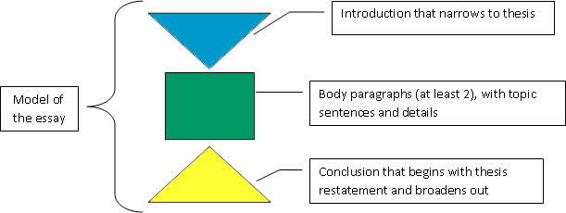

Slide 11
MAKING OUTLINES
Scheme of writing or the plan of writing
Why make an outline?
to stay focused
______________?
______________?

Slide 12
Steps to follow in making an outline
Generate ideas for the essay
Choose the most relevant idea out of the list
Narrow the listed ideas further and bring it to 2-3 keywords, maximum (remember an essay focuses on one issue (for unity and coherence across the essay)
Decide the logical order of ideas (to achieve coherence) based on the importance of points (or MPs=Main points)
Use phrases, headings or keywords (For quick reference while writing)
For body paragraphs, select relevant main points and supporting details (Unity and coherence within the paragraph)
Revise above details, write a rough draft

